Slide 1
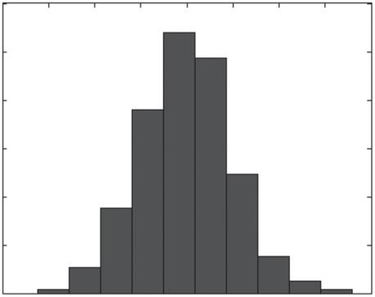
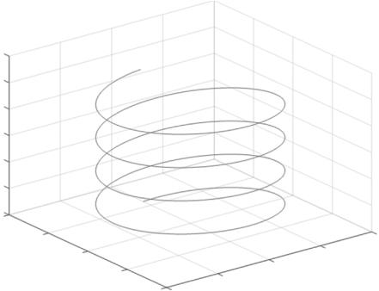
30
Chemical Engineering Computation with MATLAB®
300
250
200
150
100
50
0
–4
–3
–2
–1
0
1
2
3
4
FIGURE 1.14 Histogram by the function hist.
Trail Version
Trail Version
Trail Version
Trail Version
Trail Version
Trail Version
Trail Version
Trail Version
Trail Version
Trail Version
Trail Version
Trail Version
Trail Version
30
25
20
15
10
5
0
2
1
0
0
x
0.5
1
y
–1
–2 –1
–0.5
FIGURE 1.15 Example of 3D curve.
1.11 ORDINARY DIFFERENTIAL EQUATIONS
MATLAB has a range of functions for solving ordinary differential equations (ODE). Each of
MATLAB’s ODE solvers is designed to be efﬁcient in speciﬁc circumstances. The function ode45
implements an adaptive Runge–Kutta algorithm and is typically the most efﬁcient solver. As an
example to use the function ode45, let’s solve the following initial value ODE on the interval 0≤t≤3:
( )
dy t
= -y(t)-sin(3t), y(0)= 1
dt
The function ﬁle ode1.m deﬁnes the ODE equation to be solved:
function dy = ode1(t,y)
% dy = myode1(t,y) solves ODE.

Slide 2
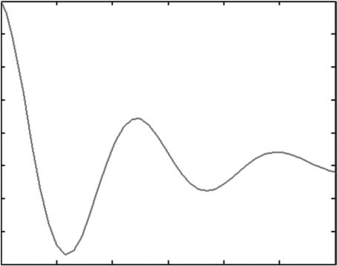
Introduction to MATLAB®
31
1
0.8
0.6
0.4
0.2
0
–0.2
–0.4
–0.6
0
0.5
1
1.5
2
2.5
3
FIGURE 1.16 Solution of simple ODE.
dy = - y - 5*exp(-t)*sin(5*t);
end
Trail Version
Trail Version
Trail Version
Trail Version
Trail Version
Trail Version
Trail Version
Trail Version
Trail Version
Trail Version
Trail Version
Trail Version
Trail Version
Then, in the Command Window, type:
>> tinv = [0 3]; y0 = 1;
>> [t,y] = ode45(@ode1,tinv,y0);
>> plot(t,y)
where tinvdeﬁnes the time interval 0≤t≤3 and y0=1represents the initial condition. The solu-
tion is shown in Figure 1.16.
1.12 EXAMPLES
1.12.1 population groWth modEl
A population growth model can be expressed as x_{k+1} =ax (1−x ). The following M-ﬁle deﬁnes this
model:
k
k
function [t, x] = pgmodel(a, xinit, n)
x(1) = xinit; t(1) = 0;
for k = 2:n+1;
t(k) = k-1;
x(k) = a*x(k-1)*(1-x(k-1));
end
end
This M-ﬁle should be stored as pmod.m. In the Command Window, specify the values of a (=2.9),
the initial value (=0.2), and the computing time (=25), and call the function pmod. Figure 1.17
shows the resultant plot.
>> [tv, xv] = pgmodel (2.9, 0.2, 25);
>> plot(tv, xv), xlabel('Time'), ylabel('Population')
>> title('Population growth model')

Slide 3
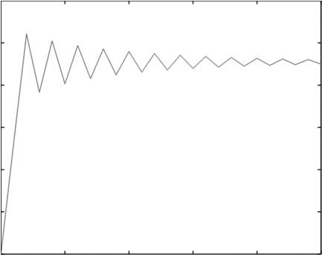
32
Chemical Engineering Computation with MATLAB®
0.8
0.7
0.6
0.5
0.4
0.3
0.2
Population growth model
0
5
10
Time
15
20
25
FIGURE 1.17 Population growth curve.
1.12.2 random fiBonaCCi sEquEnCE
Trail Version
Trail Version
Trail Version
Trail Version
Trail Version
Trail Version
Trail Version
Trail Version
Trail Version
Trail Version
Trail Version
Trail Version
Trail Version
A random Fibonacci sequence {x } is generated by choosing x and x and setting
n
1
2
x_{n+1} = x_{n} ± x_{n-1}
, n ³ 2
where ± indicates that ꢀ and ꢁ must have equal probability of being chosen. For large n, the quantity
|x_{n}| increases like a multiple of d^{n}, where d = 1.13198824…. In the MATLAB editor window, create
the script M-ﬁle as follows and save it (the ﬁle name is ranfib.m):
% ranfib.m : a random Fibonacci sequence
clear; rand('state',100)
% Set random number state.
% number of iterations
% initial condition
% for loop
m = 1000;
x = [1 2];
for n = 2:m-1
end
x(n+1) = x(n) + sign(rand-0.5)*x(n-1);
semilogy(1:1000,abs(x))
d = 1.13198824;
hold on
semilogy(1:1000, d.^[1:1000])
hold off
Here, the forloop stores a random Fibonacci sequence in the array x. MATLAB automatically
extends x each time a new element x(n+1)is assigned. The semilogyfunction then plots n on
the x-axis against abs(x) on the y-axis, with logarithmic scaling for the y-axis. Typing hold on tells
MATLAB to superimpose the next picture on top of the current one. The second semilogyfunc-
tion produces a line of slope d. Now type
>> ranfib
at the command line. This will create the graph shown in Figure 1.18.

Slide 4
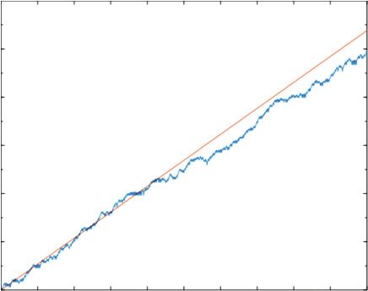
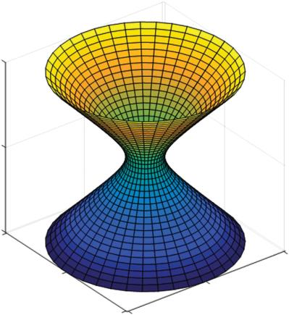
Introduction to MATLAB®
33
10⁶⁰
10⁵⁰
10⁴⁰
10³⁰
10²⁰
10¹⁰
10⁰
0
100 200 300 400 500 600 700 800 900 1000
FIGURE 1.18 Random Fibonacci sequence.
1.12.3 gEnEration of a 3d oBjECt
Let’s generate a volume-swept 3D object as shown in Figure 1.19. The script twinobj.m uses the
command surf(X,Y,Z) to create a 3D surface where the height Z is speciﬁed at the points X and Y
in the x–y plane.
Trail Version
Trail Version
Trail Version
Trail Version
Trail Version
Trail Version
Trail Version
Trail Version
Trail Version
Trail Version
Trail Version
Trail Version
Trail Version
% twinobj.m : generate a volume-swept three-dimensional (3D) object
clear all;
N = 40;
% number of increments
z = linspace(-5,5,N)';
5
0
–5
5
0
5
0
–5 –5
FIGURE 1.19 A volume-swept three-dimensional (3D) object.

Slide 5
34
Chemical Engineering Computation with MATLAB®
radius = sqrt(1+z.^2);
theta = 2*pi*linspace(0,1,N);
X = radius*cos(theta);
Y = radius*sin(theta);
Z = z(:,ones(1,N));
surf(X,Y,Z)
axis equal
BIBLIOGRAPHY
Attaway, S., MATLAB, 3rd ed., Butterworth-Heinemann, Kidlington, Oxford, UK, 2013.
Burstein, L., MATLAB in Quality Assurance Sciences, Woodhead Publishing, Sawston, Cambridge, UK, 2015.
Gdeisat, M. and F. Lilley, MATLAB by Example: Programming Basics, Elsevier, Waltham, MA, 2013.
Gilat, A., MATLAB: An Introduction with Applications, 4th ed., John Wiley & Sons, Inc., Hoboken, NJ, 2011.
Hanselman, D. and B. Littleﬁeld, Mastering MATLAB 7, Pearson Education International, Upper Saddle
River, NJ, 2005.
Higham, D. J. and N. J. Higham, MATLAB Guide, 2nd ed., Siam, Philadelphia, PA, 2005.
Hunt, B. R., R. L. Lipsman, and J. M. Rosenberg, A Guide to MATLAB, 2nd ed., Cambridge Press, 2006.
Knight, A., Basics of MATLAB and Beyond, Chapman & Hall/CRC, Boca Raton, FL, 2000.
McMahon, D., MATLAB Demystiﬁed, McGraw-Hill, New York, N Y, 2007.
Moore, H., MATLAB for Engineers, 2nd ed., Pearson Educational International, Upper Saddle River, NJ, 2009.
Palm III, W. J., Introduction to MATLAB for Engineers, 3rd ed., McGraw-Hill, New York, N Y, 2012.
Yeo, Y. K., Introduction to MATLAB Programming (in Korean), 4th ed., Ajin, Seoul, Korea, 2016.
Trail Version
Trail Version
Trail Version
Trail Version
Trail Version
Trail Version
Trail Version
Trail Version
Trail Version
Trail Version
Trail Version
Trail Version
Trail Version

Slide 6
2
Numerical Methods
with MATLAB®
Mathematical models of chemical processes typically involve a complex system of equations. In the
ﬁeld of chemical engineering, most mathematical process models usually consist of linear and non-
linear equations, ordinary and partial differential equations, or some combinations of these. In order
to investigate the process characteristics, it is necessary to solve the equations using numerical meth-
ods. This chapter covers the fundamentals of numerical methods with an emphasis on application
using MATLAB®. The topics include solving systems of linear equations, ﬁnding roots of equations,
polynomial approximation (including interpolation and curve ﬁtting), numerical differentiation and
integration, optimization, and solving ordinary and partial differential equations. It is assumed that
the reader is already familiar with the underlying theories of the topics covered, so this text will only
provide a cursory overview of the theories where necessary.
Numerical methods presented as MATLAB programs are as easy to read and understand as those
presented as algorithms or pseudocode. MATLAB also has very convenient graphing capabilities
and powerful built-in functions for almost all key numerical methods. Lastly, MATLAB’s vector–
matrix formulation of operations is an excellent basis for the methods of scientiﬁc computing.
This chapter serves as a primer on general programming and algorithm implementation using
MATLAB while also presenting MATLAB as a viable problem-solving tool for chemical engi-
neers. MATLAB programs listed in this book are kept as modular as possible to maximize reus-
ability. Much attention has been devoted to the documentation and annotation of the programs
developedꢀhere.
Trail Version
Trail Version
Trail Version
Trail Version
Trail Version
Trail Version
Trail Version
Trail Version
Trail Version
Trail Version
Trail Version
Trail Version
Trail Version
2.1 LINEAR SYSTEMS
When chemical processes are modeled mathematically, they are occasionally described by systems
of linear equations. In this section, we will examine how such equation systems are solved. Let’s
consider the simultaneous linear equations represented by the following:
a x + a x +ꢀ+ a x = b
1
11
1
12
2
1n
n
a x + a x +ꢀ+ a x = b
2
21
1
22
2
ꢁ
2n
n
a x + a x +ꢀ+ a x = b
n
n1
1
n2
2
nn
n
There are n unknown variables x , x , …, x and n linear algebraic equations. In general, linear equa-
1
2
n
tion systems can be expressed in terms of vectors and matrices as
Ax = b
where
A is an n × n matrix of known coefﬁcients
x is the column vector of n unknowns
b is a column vector of n known coefﬁcients as shown below
35

Slide 7
36
Chemical Engineering Computation with MATLAB®
éa
a₁₂
ꢀ
ꢀ
ꢁ
a ù
éx ù
éb ù
11
1n
1
1
ê
ê
ê
ê
ú
ê
ê
ê
ê
ú
ê
ê
ê
ê
ë
ú
ú
ú
ú
û
a
21
ª22
a
ú
x
b
2
^{2n} ,
ú
=
x =
² , b =
A
ꢁ
ꢁ
ú
ú
ú
ú
ꢁ
ꢁ
ꢁ
ëa
a_{n2}
ꢀ
a û
ëx û
b
n
n1
nn
n
If the coefﬁcient matrix A is square and nonsingular, the solution of the linear system is given by
x = A⁻¹b
If matrix A is not square (i.e., A∈ R^{m × n}, m>n), we cannot compute A⁻¹ and the solution cannot be
obtained from the above relation. If we multiply A^{T} on both sides of the linear system, we have
A^{T} Ax = A^{T} b
The product A^{T}A is square, so we can ﬁnd the inverse of the product. Thus, we obtain
(
)⁻¹
x = A^{T} A A^{T} b
Letting
Trail Version
Trail Version
Trail Version
Trail Version
Trail Version
Trail Version
Trail Version
Trail Version
Trail Version
Trail Version
Trail Version
Trail Version
Trail Version
A⁺ ⁼ ⁽A^{T} A₎⁻¹ A^{T}
we have
x = A⁺b
The matrix A+ is called the Moore–Penrose pseudoinverse of A. We can use MATLAB®’s built-in
function pinv to compute A+. In most cases, the solution of linear systems can be found by using the
MATLAB backslash operator (\).
Example 2.1: Pseudoinverse of a Matrix
Use MATLAB®’s built-in function pinv to compute the pseudoinverse of
é-2 -1
3 ù
ê
-5
2
ú
4
6
7
- ú
5
ê
ê
ê
ú
A =
ú
ê-3
ë
2
1 ú
û
Solution
>> A = [-2 -1 3; 4 -5 7; 6 2 -5; -3 2 1];
>> Ap = pinv(A)
Ap =
-0.0109 0.0948 0.1437 0.0878
0.0506 0.0615 0.2103 0.4689
0.0620 0.1294 0.0744 0.2802

Slide 8
Numerical Methods with MATLAB®
37
Example 2.2: Solution of a Linear System Using the Backslash Operator (\)
Use the backslash operator to solve the following equation system:
4x + 2x - x = 8
1
2
3
-3x + x + 2x = -6
1
2
3
2x - 4x + x = 12
1
2
3
Solution
The solution is given by x = A\c. In this problem, the coefﬁcient matrix A is nonsingular and the
inverse of A can be used to ﬁnd the solution.
>> A = [4 2 -1; -3 1 2; 2 -4 1]; b = [8; -6; 12];
>> x = A\b
x =
3
-1
2
>> x = inv(A)*b
x =
3
-1
2
Trail Version
Trail Version
Trail Version
Trail Version
Trail Version
Trail Version
Trail Version
Trail Version
Trail Version
Trail Version
Trail Version
Trail Version
Trail Version
Example 2.3: Heat Conduction
Figure 2.1 shows a ﬂat square plate with its sides held at constant temperatures. Find the tempera-
ture at each node x , x , x , and x . Each dot represents a node, and the temperature at each node
1
2
3
4
is assumed to be given by the average temperatures of adjacent nodes.
Solution
1
4
1
4
1
4
x₁ =
(
),
(
),
(30 )
+ x₁ + x₄ + 25 ,
30 +15+ x₂ + x₃
=
+
+
+
=
x₂
x₁ 15 20 x₄
x₃
1
4
x₄ =
(
)
x + x + 20 + 25
3
2
The above relationship can be rearranged in the form of a system of linear equations as
4x - x - x = 45, - x + 4x - x = 35, - x + 4x - x = 55, - x - x + 4x = 45
1
2
3
1
2
4
1
3
4
2
3
4
or
é 4
-1 -1 0 ù é x ù é45ù
1
ê
ú ê
ú
ê
ê
ê
ê
ú
ú
ú
ú
-1
ê-1
4
0
0
4
-1
x
35
55
ê
ú ê ² ú
-1ú ê
=
ú
ú
x₃
ê
ú ê
ê 0
-1 -1 4 ú êx ú ê45ú
ë
û ë
û
ë
û
4
We can use the backslash operator.
>> A = [4 -1 -1 0; -1 4 0 -1; -1 0 4 -1; 0 -1 -1 4];
>> b = [45 35 55 45]';
>> x = A\b
x =
22.5000
20.0000
25.0000
22.5000

Slide 9
Trail Version
Trail Version
Trail Version
Trail Version
Trail Version
Trail Version
Trail Version
Trail Version
Trail Version
Trail Version
Trail Version
Trail Version
Trail Version

Slide 10
Numerical Methods with MATLAB®
39
Since each node is square, Δx = Δy, and by rearranging we have
^{q}4^{Dx}
kA
= 2T + 2T - 4T
4
5
9
At steady state, q /kA is assumed to be zero. Find temperatures T , T , …, T at nodes 4 through 12.
Solution
4
4
5
12
From the heat balance at each node, and considering the boundary conditions, we have
T = T = T = 500°F
1
2
3
T
13
= T = T = T = T = T = 200°F
14 15 16 17 18
At node 4: -4T + 2T + 2T = 0
4
5
9
At node 5:T - 4T +T +T = -500
4
5
6
10
At node 6:T - 4T +T +T = -500
5
6
7
11
At node7: 2T - 4T +T = -500
6
7
12
At node8: -4T + 2T = -400
Trail Version
Trail Version
Trail Version
Trail Version
Trail Version
Trail Version
Trail Version
Trail Version
Trail Version
Trail Version
Trail Version
Trail Version
Trail Version
8
9
At node 9:T +T - 4T +T = -200
4
8
9
10
At node10:T +T - 4T +T = -200
5
9
10
11
At node11:T₆ +T - 4T₁₁ +T = -200
10
12
At node12:T + 2T - 4T = -200
7
11
12
The above linear equations can be solved by using the backslash operator as shown below:
>> A = [-4 2 0 0 0 2 0 0 0;1 -4 1 0 0 0 1 0 0;0 1 -4 1 0 0 0 1 0;...
0 0 2 -4 0 0 0 0 1;0 0 0 0 -4 2 0 0 0;1 0 0 0 1 -4 1 0 0;...
0 1 0 0 0 1 -4 1 0;0 0 1 0 0 0 1 -4 1;0 0 1 0 0 0 0 2 -4];
>> b = [0 -500 -500 -500 -400 -200 -200 -200 -200]';
>> x = A\b
x =
311.9011
369.4600
387.6418
391.7217
227.1712
254.3423
278.2969
289.3855
291.6032
The results are summarized as follows:
T₄ = 311.9011°F, T₅ = 369.4600°F, T₆ = 387.6418°F, T₇ = 391.7217°F, T₈ = 227.1712°F
T₉ = 254.3423°F,
T = 278.2969°F, = 289.3855°F, = 291.6032°F
T T
10 11 12

